Slide 1

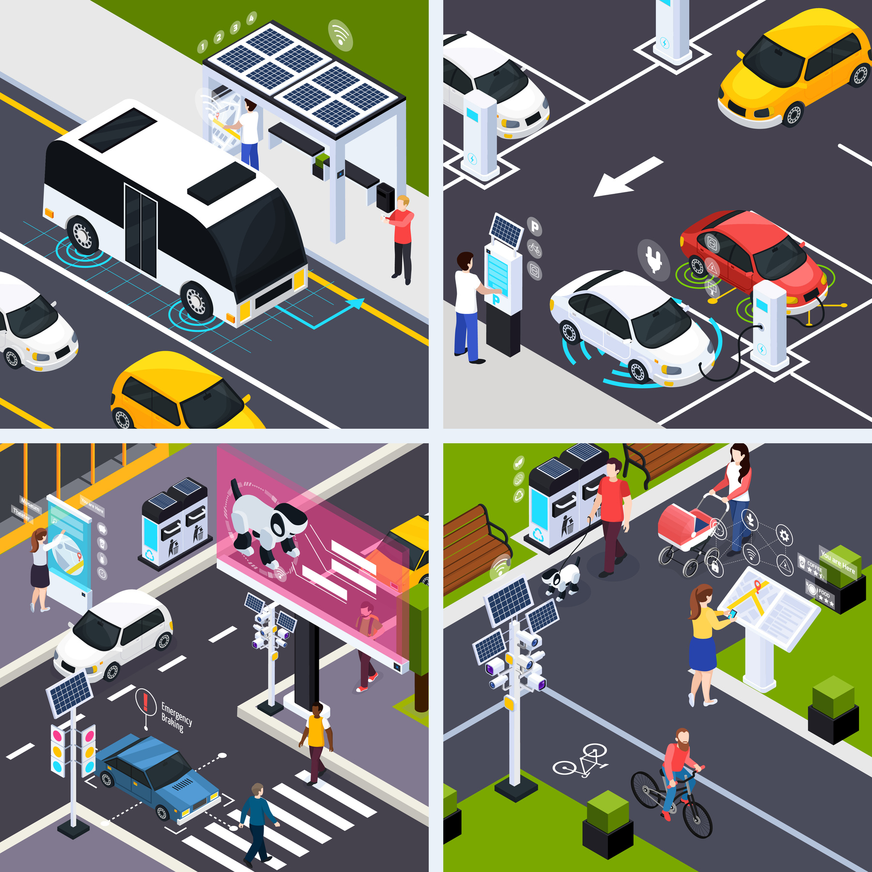



Pseudo E-Challan Generation & Traffic Violation Detection System
Using C++, OpenCV, JSON/Struct Databases, Dynamic Arrays & GUI
Proposal by Group-D

Slide 2

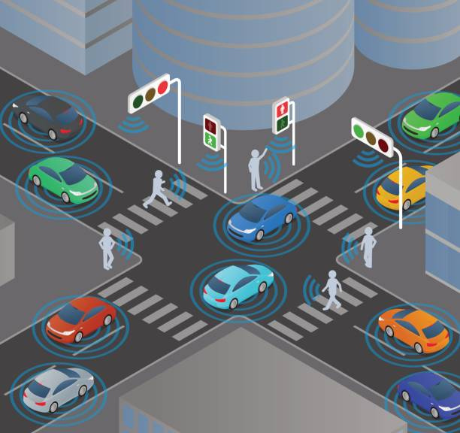

Group Members
1.Muhammad BSSE25002
2.Minahil Hammad BSSE25045
3.Syeda Eman Fatima BSSE25038
4.Fatima Saeed BSSE25013

Slide 3
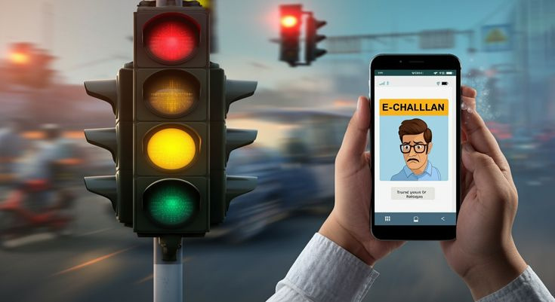

Traffic violations often go unnoticed due to limited manual monitoring.
Existing challan systems rely heavily on manual entry and physical verification.
Problem Statement
Lack of automated plate detection causes delays in issuing challans.
There is a need for a lightweight, file-based prototype that simulates real-world traffic enforcement workflows.

Slide 4




Build a fully automated, pseudo e-challan system using C++ and OpenCV.
Detect traffic violations through camera feeds and extract number plates.
Auto-generate challans and maintain them in file-based pseudo databases (JSON, structs, 2D dynamic arrays).
Integrate a pseudo-bank for simulated payment management.
Provide a GUI interface for user interaction, challan viewing, and status updates.
Send email notifications to registered vehicle owners after challan generation.

Slide 5

Main Features to Include
Feature 1
Feature 2
Feature 3
Feature 4
Real-time or image-based vehicle detection using OpenCV.
Automatic number plate extraction using contouring & segmentation.
Violation detection engine (speeding, signal jump, lane crossing — rule-based).
E-Challan auto-generation with time, location, image proof & violation type.
Feature 5
Feature 6
Feature 7
Feature 8
Pseudo-databases implemented using JSON, structs, and dynamic 2D arrays.
Email notification module to alert owners with challan details.
GUI dashboard for registration, challan info, payment, and user management.
Pseudo-bank system that stores balances, processes payments, and updates records.

Slide 6


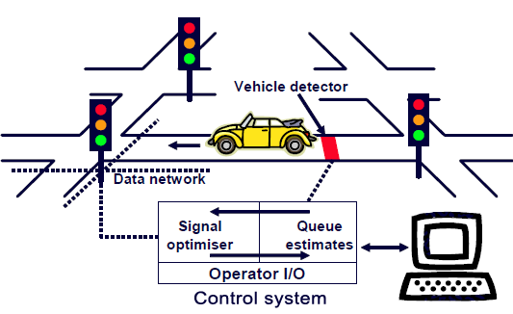
Inputs
• Live camera feed or uploaded image.
• Vehicle number plate text detected via OpenCV.
• User inputs for payments, registration updates, and new entries.
• Administrator controls for adding violations or updating databases.
Arguments of the Project
Outputs
• Generated challan file in JSON/text format.
• Updated registration, bank, and challan database files.
• Email sent to the vehicle owner with challan details.
• GUI-generated visual display of challans, balances, and violation data.
• Status updates (PAID/UNPAID) after performing payment operations.
Overview of the project dynamics

Slide 7


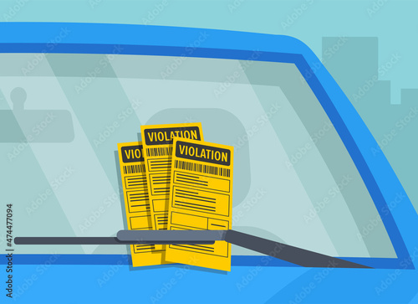
Pseudo Databases
1. Registration Database
2. Bank Database
3. Challan Database
• JSON + Structs containing:
– Vehicle number plate
– Owner name
– Email address
– CNIC / ID
– Vehicle model
• Supports: add new user, update records, search by number plate
• Uses dynamic 2D arrays to store:
– Account ID
– Current balance
– Transaction history
• Handles: recharge, deduction for challans, balance validation
• JSON-based challan entries with:
– Challan ID
– Number plate
– Violation type
– Date & time
– Fine amount
– Payment status
• Supports: update status, append new challans, display history

Slide 8



Core System Modules
Image Processing Module | Violation Detection Engine | GUI Front-End | Notification System | Finance Manager (Pseudo Bank) | Challan Manager
Reads camera frames | Rule-based logic/Pre-Trained Model | Dashboard view | Sends email alerts via SMTP | Deducts fine amounts | Creates new challan entries
Detects vehicles & plates | Detects traffic violations automatically | User profile view |  | Updates balances | Assigns unique challan IDs
Performs character segmentation |  | Challan/payment interface |  | Marks challans PAID | Links challans to user accounts

Slide 9


Workload Breakdown
Part_1: OpenCV Module
Part_2: Database Manager
Part_3: Finances
Part_4: GUI+Email
Part_5: Individual Records Analysis
Detection, Plate Extraction
Plate text + violation Image
=> Minahil BSSE25045
Entries, Fetching, Setup
JSON entries, Data extraction, Dynamic Array Manager
=> Muhammad BSSE25002
Bank Management,
Challan Payments, Accounts Management
=> Eman BSSE25038
GUI setups for the project
Email Notifications to the users
=> Fatima BSSE25013
Analysis of Records of generated Challans for Individuals.
=> Rafay BSSE25037

Slide 10

Task List (Detailed Breakdown)
Phase 1 — System Setup
Phase 2 — Image & Camera Processing
Phase 3 — Violation Detection
Phase 4 — Pseudo Databases
Set up project structure & file-based pseudo databases
Implement camera/image input handling
Rule-based logic
– Detects traffic violations automatically
• Build registration, challan & bank data files
• Add dynamic array-based financial records

Slide 11
Task List (Detailed Breakdown)
Phase 5 — Challan Workflow
Phase 6 — Payment System
Phase 7 — Email Integration
Phase 8 — GUI Development
Phase 9 — Testing
• Generate challans automatically
• Save challans in database
• Connect challans to owners
• Simulate financial transactions
• Update payment status
• Generate receipts
• Implement SMTP service
• Auto-send challan notifications
• Build simple, intuitive interface
• Add views for registration, challans, payments
• Test detection with multiple images
• Validate payment and email workflow
• Final debugging and refinement

